Slide 1


Introduction to the PRISM Weather and Climate Mapping System
Christopher Daly, Ph.D.
Founder and Director, PRISM Climate Group
Author, PRISM Climate Mapping System
Northwest Alliance for Computational Science and Engineering
Oregon State University

Slide 2


Why Does Crop Insurance Use PRISM Data?
Most crop losses are weather-related
Weather-related crop loss claims need to be verified
Many farms are located in rural areas distant from the nearest weather station
There is a therefore a great need for high-quality estimates of weather conditions where there are no stations
The PRISM weather and climate mapping system is ideally suited to provide this information
PRISM
GROUP

Slide 3
Outline
Introduction to PRISM
  What does it do?
  How does it work?
  Who uses it?
Overview of the PRISM/RMA web portal for loss adjusters
  What kinds of information do adjusters have access to?
  What tools are provided to access it?
  What kinds of documentation do they generate?
PRISM
GROUP

Slide 4

PRISM Climate Group Overview
Applied research team since 1991, founded and directed by Dr. Christopher Daly
Housed within the Northwest Alliance for Computational Science and Engineering, College of Engineering, Oregon State University
Climate mapping center for the USDA; de facto climate mapping center for the US
Federal sponsors cut across many departments and disciplines, including agencies within DOE, DOD, DOC, DOI, USDA, NSF, EPA

Slide 5
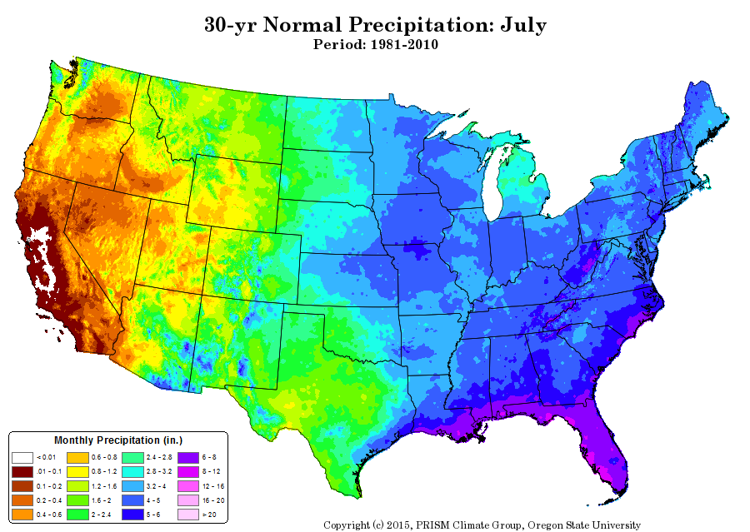
What is PRISM?
There are many locations in the US for which no weather observations exist. To create a continuous weather or climate map across the country, station observations are fed into a sophisticated computer model called PRISM (Parameter-elevation Regressions on Independent Slopes Model).
PRISM estimates weather and climate variables, such as temperature and precipitation, on a grid of millions of pixels, each measuring about 0.5 mile across the entire conterminous US, every day.
Weather maps show what occurs from day to day
Climate maps show long-term averages of weather over a period of 10-30 years
PRISM is used to produce both kinds of maps.

Slide 6
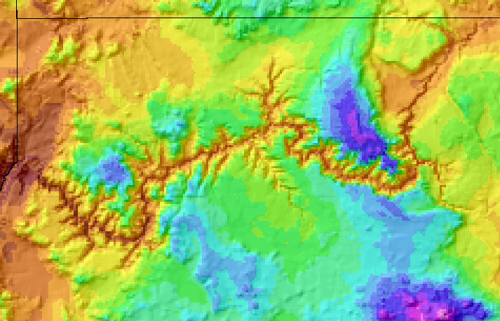
How Does PRISM Work?
For grid cells where no observations exist, PRISM mimics the thinking an expert meteorologist would follow. The model simulates how weather and climate varies with elevation, and accounts for coastal effects, temperature inversions, and terrain barriers that can cause rain shadows.
Grand Canyon temperature map:
PRISM incorporates the effects of elevation
PRISM
Station
Grid Cell

Slide 7
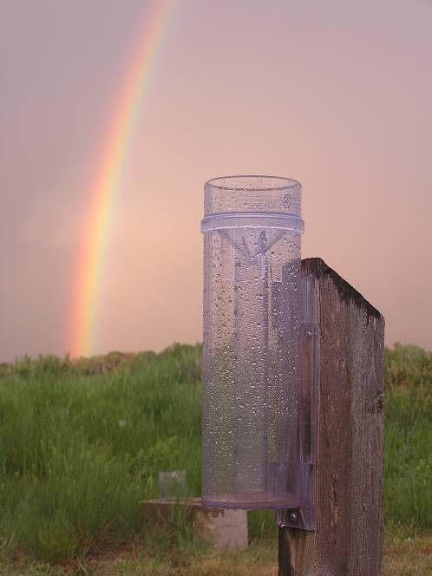
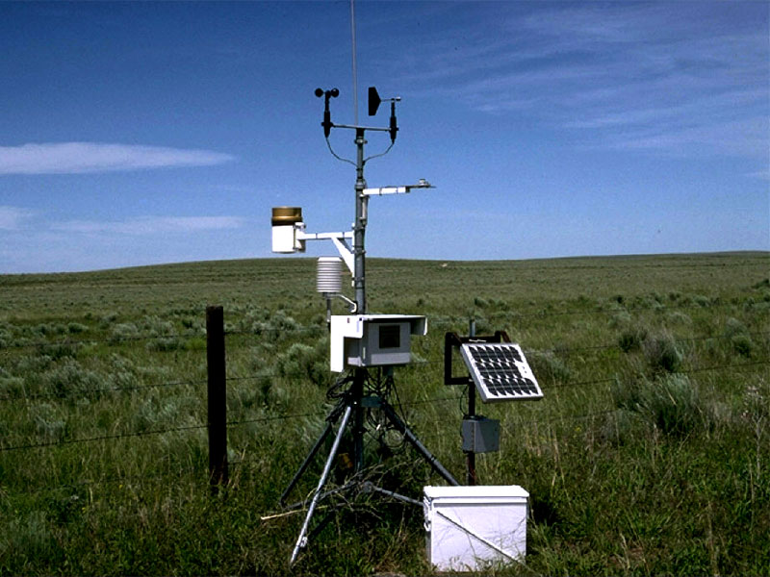
High Quality Station Data
Each day, the PRISM Climate Group collects data from over 20,000 precipitation and 6,000 temperature stations. These include all of NOAA’s major networks; those operated by the US Forest Service, Bureau of Reclamation, and USDA; the large CoCoRaHS precipitation network; state and regional systems operating in California, Colorado, Florida, Minnesota, North Dakota, and Oklahoma; and Environment Canada stations. More networks are being added all the time.
The quality of the station observations is a key factor in the accuracy of the datasets. PRISM’s comprehensive quality control system ensures that only the most accurate observations are used. PRISM personnel have close relationships with many data providers, and alert them to issues as they arise.
Automated Colorado Ag Weather Network Station
Manned CoCoRaHS rainfall station
Photos: Colorado State University

Slide 8
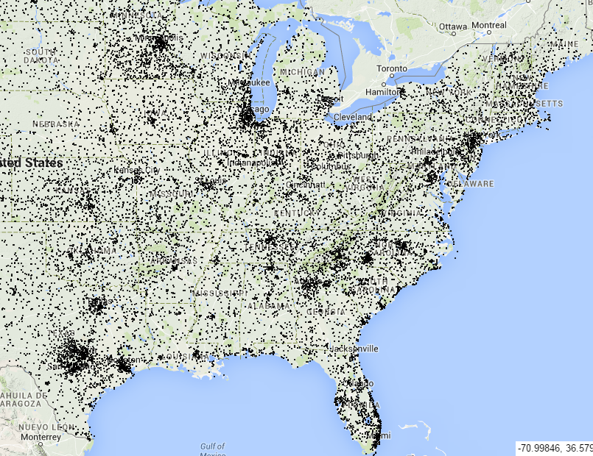
PRISM Stations
Reporting Precipitation on 1 July 2014

Slide 9
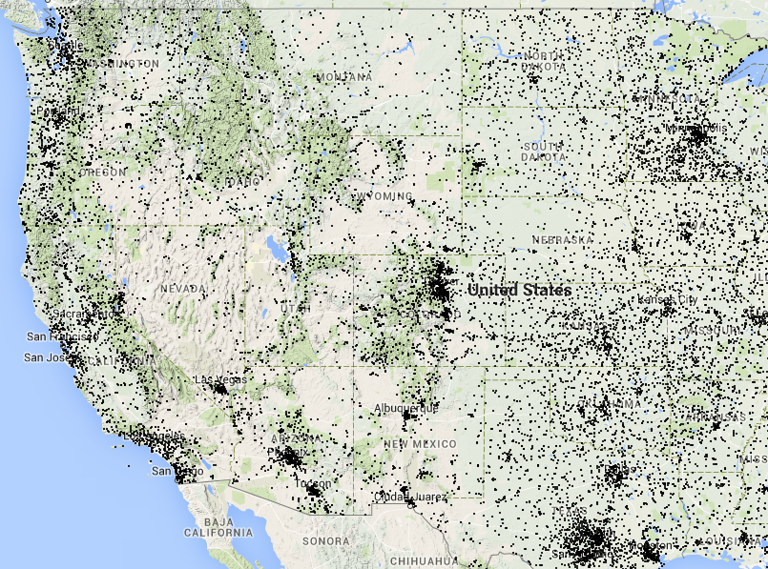
PRISM Stations
Reporting Precipitation on 1 July 2014

Slide 10
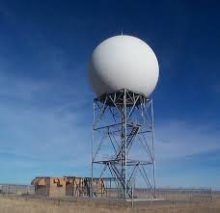
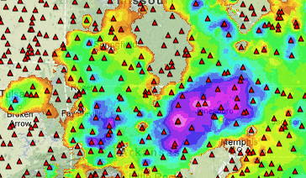
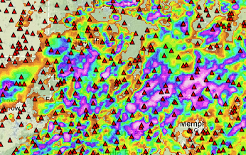
PRISM-Radar Mapping
East of the Rockies, PRISM uses NOAA weather radar to provide detailed rainfall information between stations, resulting in a more precise and accurate picture of rainfall patterns than would be possible with station data alone.
PRISM daily rainfall map for the SE US on July 1, 2003
= Station
Heavy rain cell
Stations Only
Stations + Radar

Slide 11
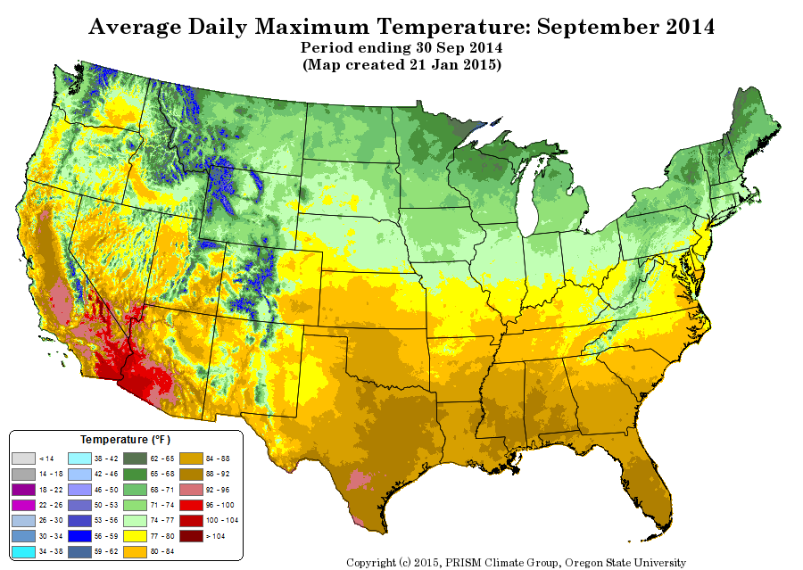
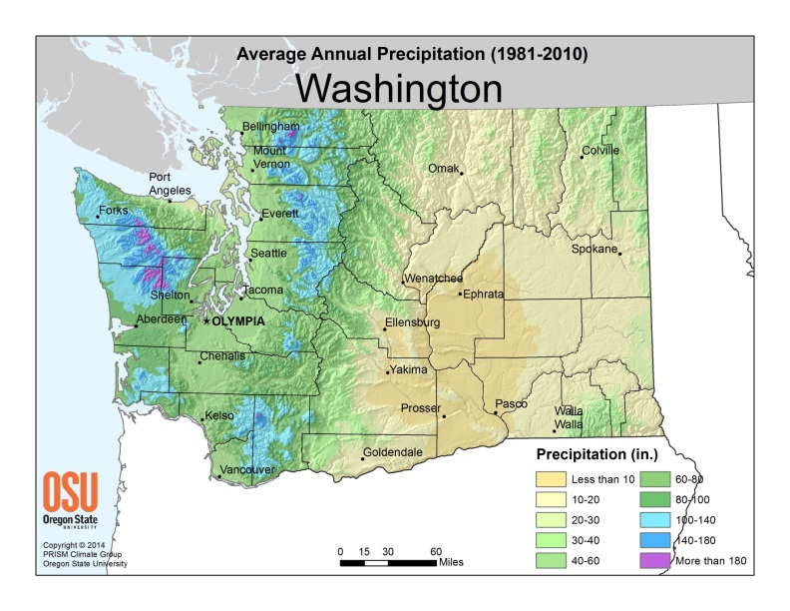
Accepted Technology
PRISM climate mapping technology has been continuously developed, and repeatedly peer-reviewed, since 1991.
Seminal paper introducing PRISM (1994) has been cited in over 2,200 peer-reviewed journal articles.
The impact of PRISM on the scientific community and the public good was recognized in 2004 when Daly was awarded “Outstanding Contribution to the Advance of Applied Meteorology” by the American Meteorological Society.

Slide 12
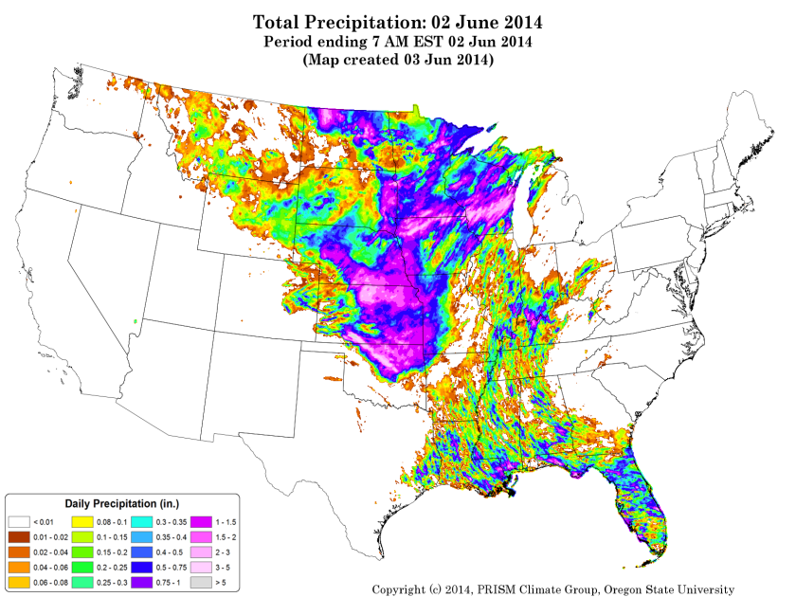
PRISM Data Usage
PRISM data are available via public website http://prism.oregonstate.edu
Since January 2014, users downloaded over 20 million gridded datasets from this site, making PRISM by far the most heavily used climate mapping service in the country
NOAA and NASA are the US government’s two largest PRISM data users
PRISM data are used in a broad range of applications in agriculture, hydrology, engineering, ecology, economics, retail, and many, many more.

Slide 13
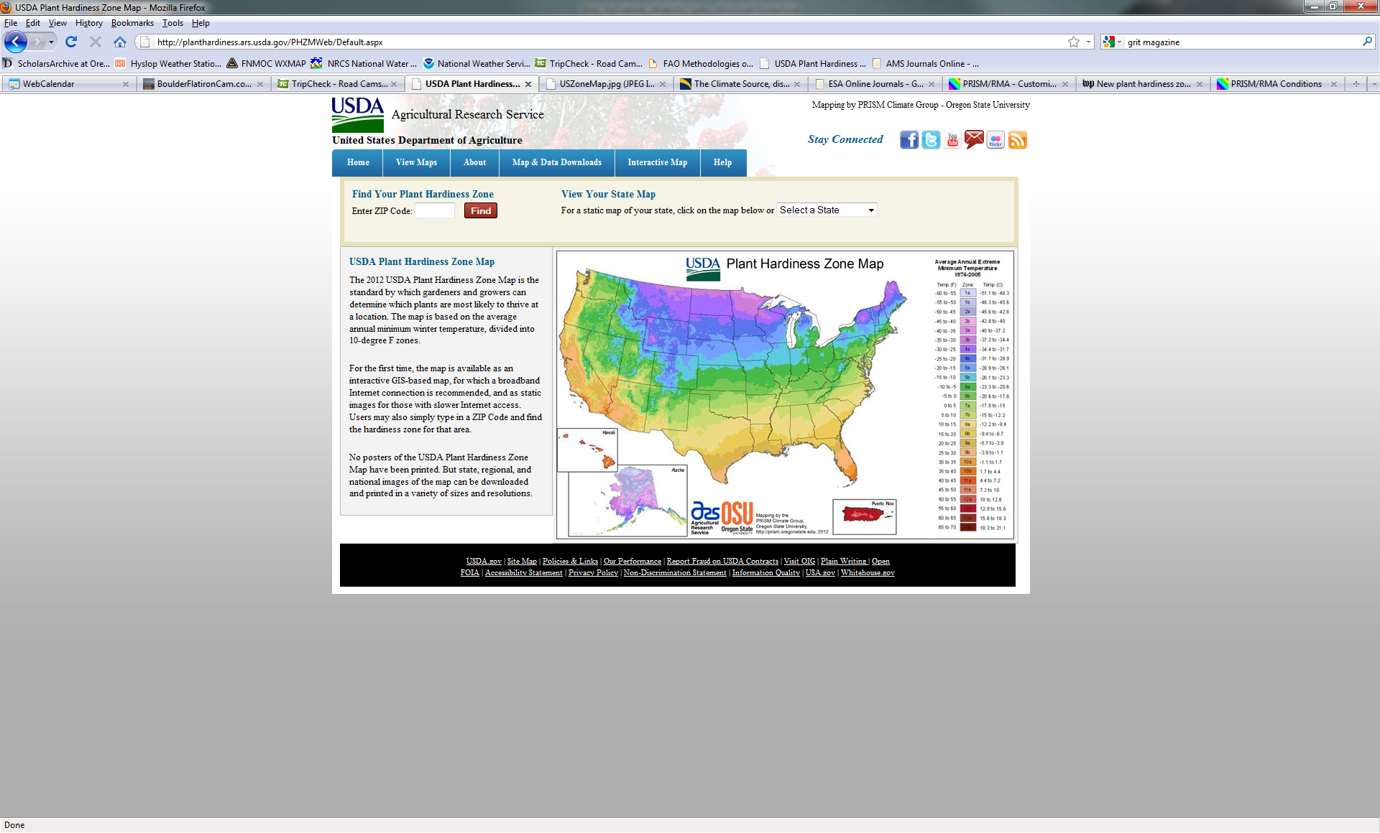
2012 USDA Plant Hardiness Zone Map
The PRISM Climate Group was chosen to author the 2012 USDA Plant Hardiness Zone map, which receives about ½ million visits per month.
It is likely the most heavily used climate map in the world.

Slide 14

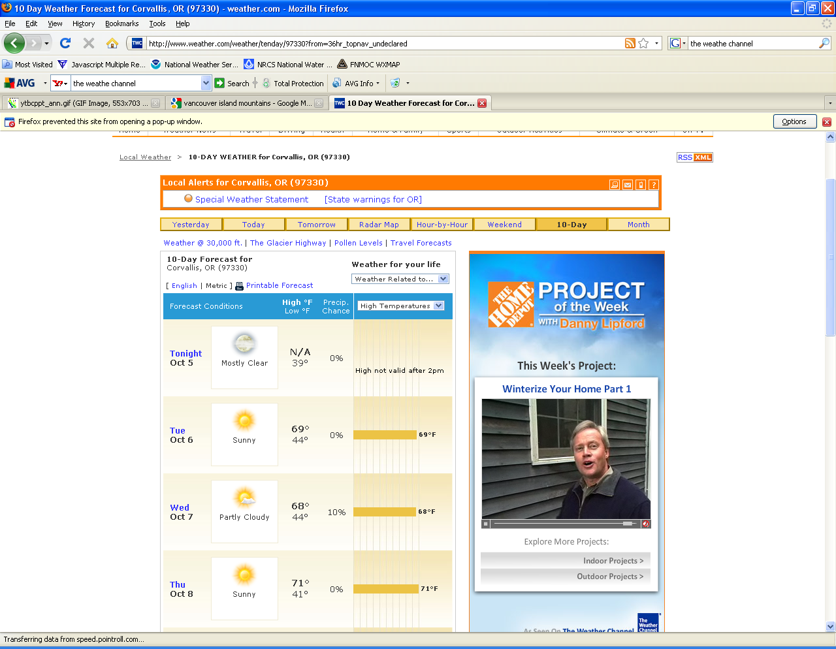
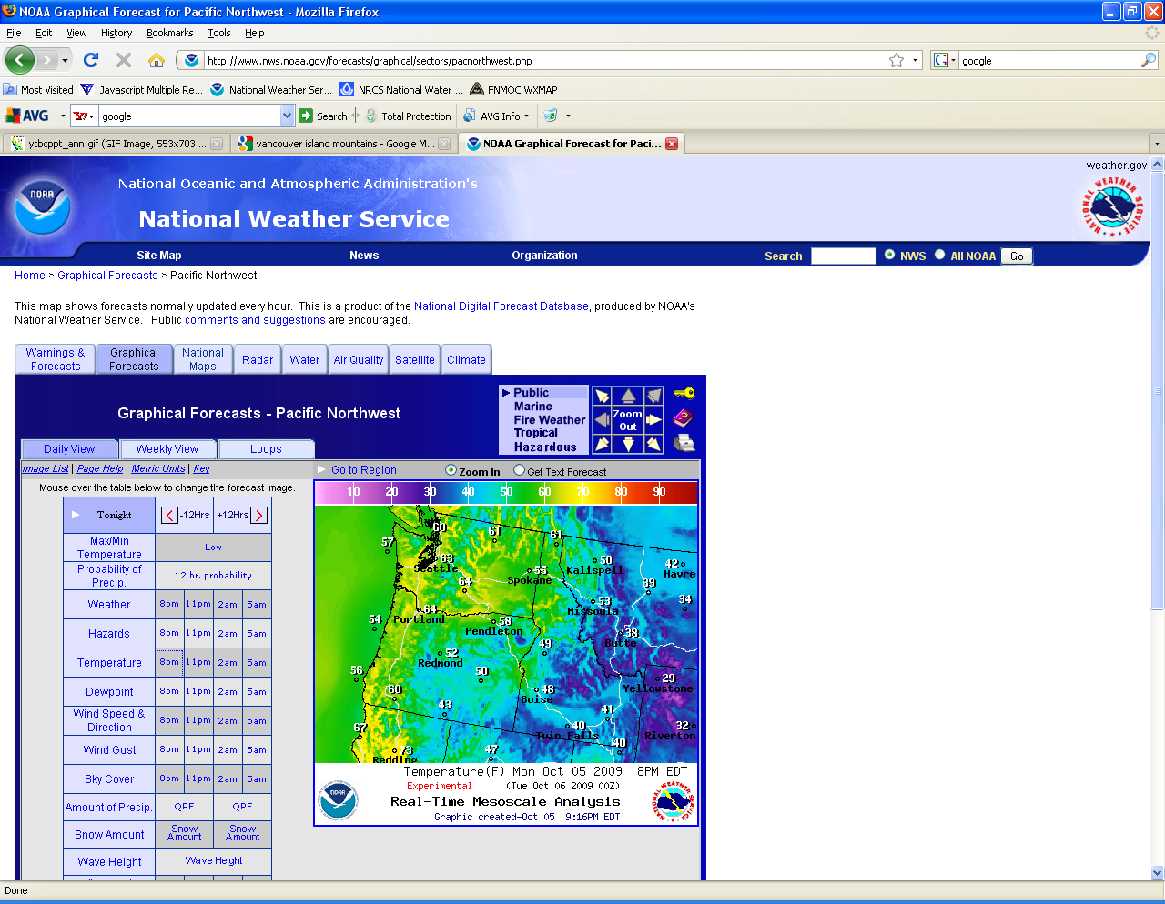
Spatial Weather Forecasts Guided by PRISM
PRISM datasets are trusted by the National Weather Service and the Weather Channel, the two largest weather forecast providers, to guide the spatial patterns of their forecasts.

Slide 15
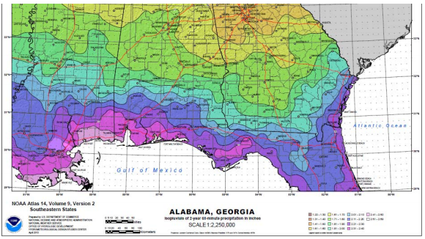
NOAA Extreme Precipitation Atlas
The PRISM Climate Group is the mapping partner for the new NOAA Atlas 14 on extreme precipitation.
The atlas is the official source for major storm precipitation data and is consulted by engineers in projects involving hydraulic design and drainage systems.
PRISM map of the greatest 60-minute rainfall expected to occur once every 2 years, SE US

Slide 16
Typical Cause of Loss Language
“Crop could not be planted due to excessively wet conditions”
“Crop failed due to insufficient moisture”
“Harvest was delayed and crop quality was reduced due to cold and wet weather”
“Crop was damaged due to unusually hot weather”
How do claims adjusters evaluate whether it really was too wet, too dry, too cold or too hot?
PRISM
GROUP

Slide 17
PRISM’s Crop Insurance Support
Purpose: Provide high-quality weather and climate data to expedite claims
  Did the claimed damaging event occur?
    Short time scale: Daily and monthly weather maps over the lower 48 states in near real time
  Was the event unusual enough to support a loss claim?
    Long time scale: Climate maps to provide context for the event
  Can the assessment process be made quick and easy?
    Web-based tools
PRISM
GROUP
Notes:
PRISM’s main goals for crop insurance compliance are to aid adjusters in determining if the claimed damaging event occurred, and whether it was unusual enough to justify a claim. To make the assessment process quick and easy, a compliance web portal was opened to RMA and the insurance companies.

Slide 18
PRISM/RMA Web Portal
PRISM/RMA web portal (password protected)
  Designed for use by USDA RMA personnel and adjusters working for approved insurance providers (AIPs)
  Satisfies RMA weather documentation requirements
  Mainly used for claims adjustment, but also for research
PRISM
GROUP
Notes:
The PRISM Climate Group exists within Oregon State University’s Northwest Alliance for Computational Science and Engineering (NACSE), which specializes in web portal development and is a pioneer in usability engineering. NACSE developed and hosts a web portal supported by RMA that is designed for insurance company crop loss claims assessment. The portal is accessed by personal user accounts, and contains data viewing and analysis tools.

Slide 19
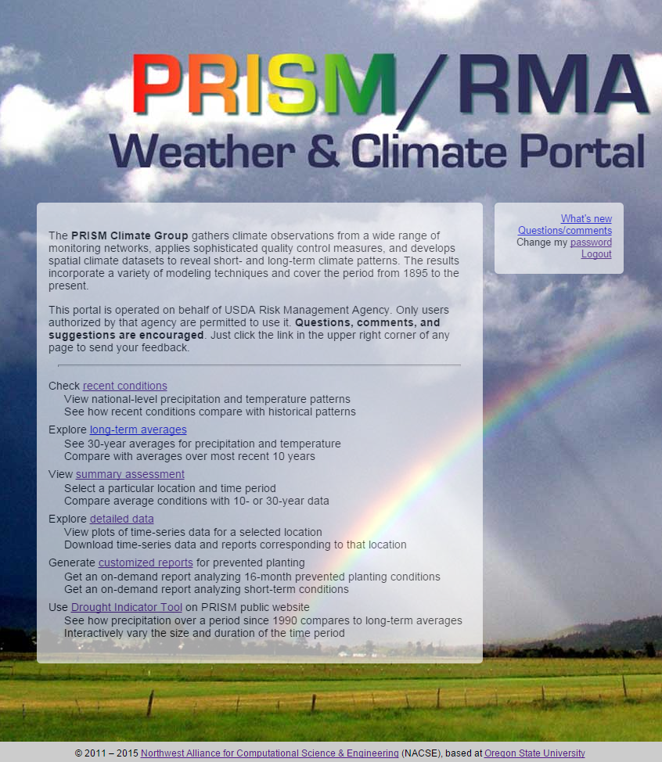

Slide 20
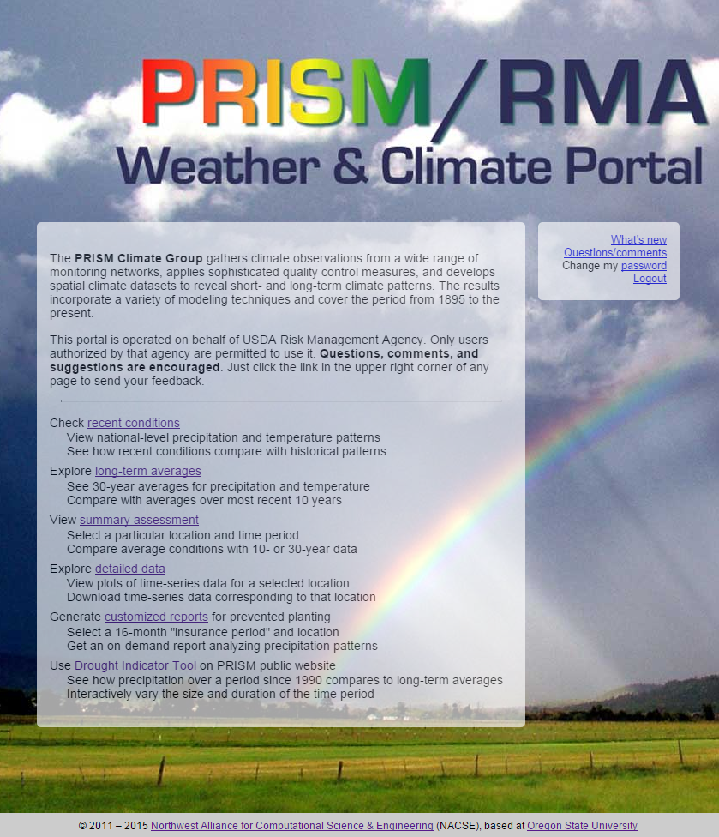
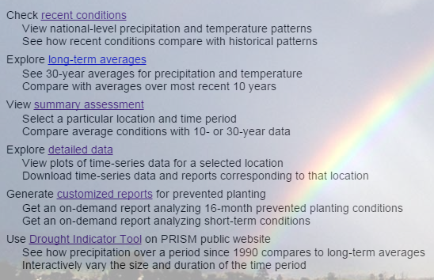
Notes:
The PRISM/RMA portal home page presents the user with six options: check recent weather conditions to see how the growing season is shaping up and anticipate claims “hot spots;” understand what long-term average conditions are like across the country; get a quick assessment of the weather for a particular place and time period to help verify a claim; take a closer look at daily or monthly data and download for further analysis; and automatically create reports on short and long-term conditions.

Slide 21
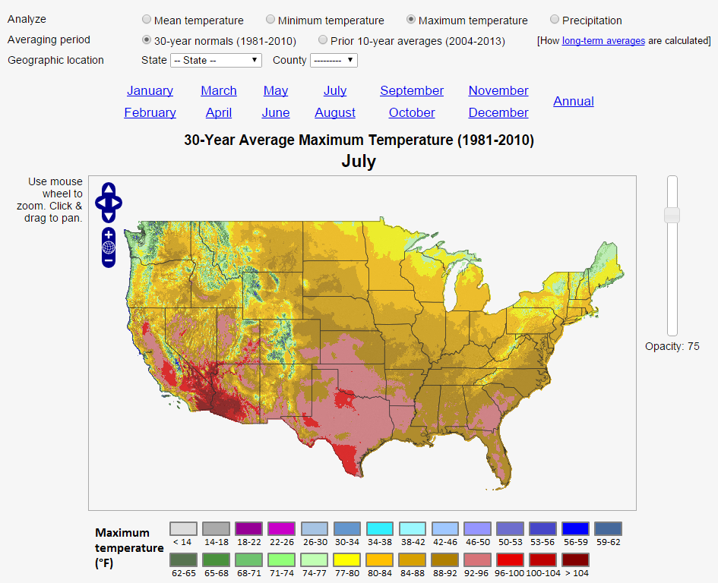
Long-Term Averages
View 30-year decadal “normal” conditions, and how they compare to most recent 10-year averages
Three decades provide a stable average, but past 10 years is in farmer’s most recent memory
Assess recent changes in climate

Slide 22
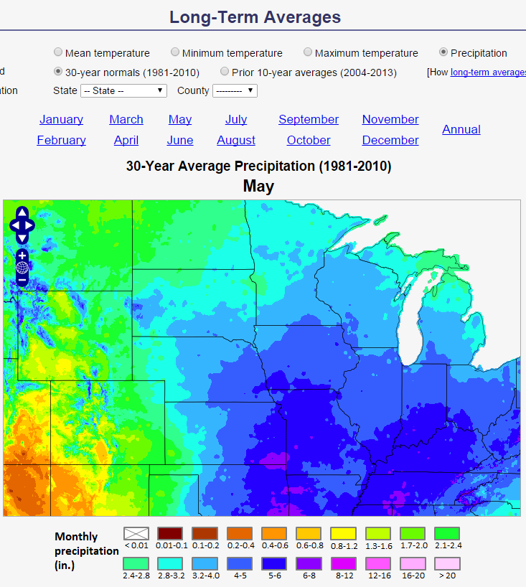
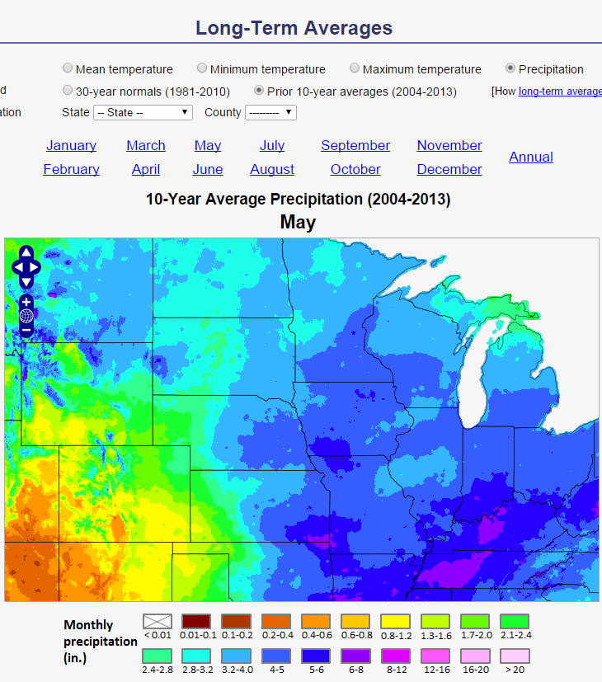
Long-Term Averages
Increased rainfall near planting time
1981-2010
May Precipitation
2004-2013
Notes:
The long-term averages section presents PRISM monthly temperature and precipitation maps for the 1981-2010 normal period on a simple map server. Averages over the most recent 10-year period are provided for comparison to indicate how the averages are trending in time. These example maps show May average precipitation for the 1981-2010 normal period (left) and the 2004-2013 period (right). The most recent 10-year average shows noticeable increases in precipitation in the upper plains during the typical planting time, compared to the 30-year normal.

Slide 23
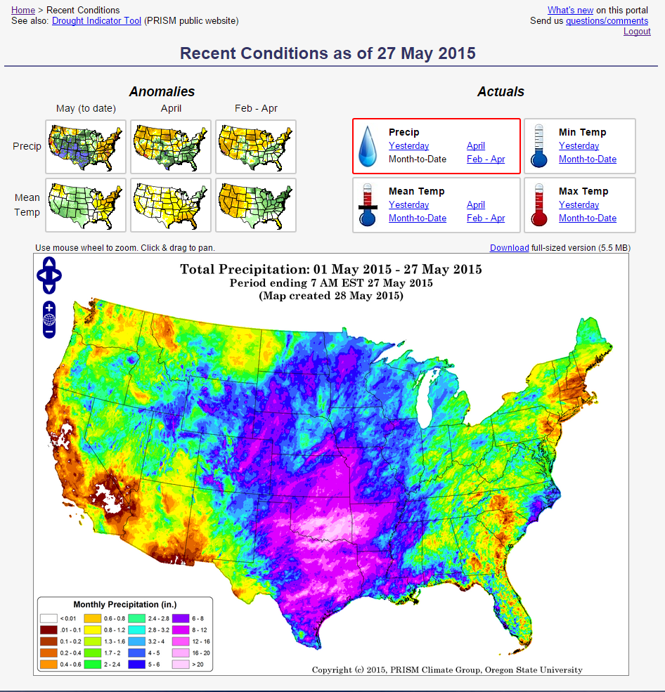
Recent Conditions
Quick map-based overview of current and recent conditions across the country – actuals and anomalies from normal.
Total Precipitation
May1-27, 2015

Slide 24
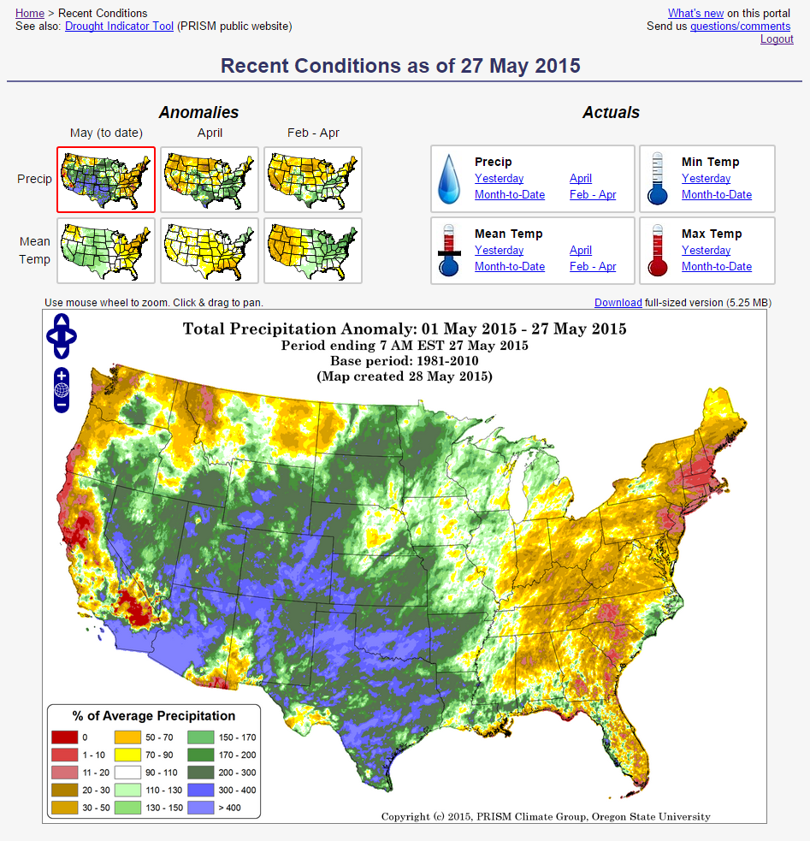
Recent Conditions
Precipitation Departure from Normal
May 1-27, 2015

Slide 25
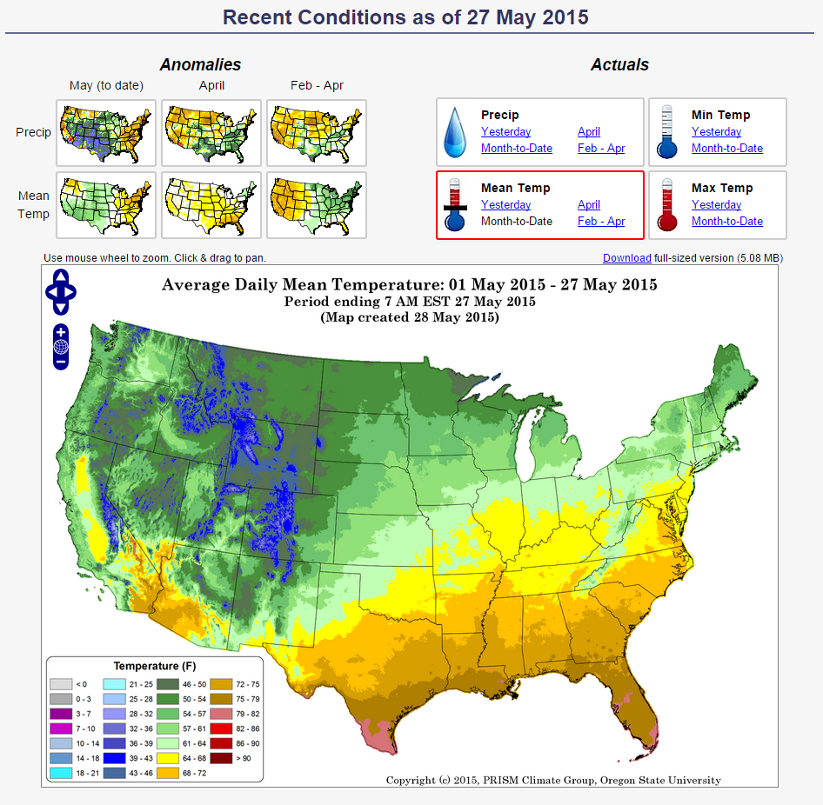
Recent Conditions
Actual Mean Temperature
May 1-27, 2015

Slide 26
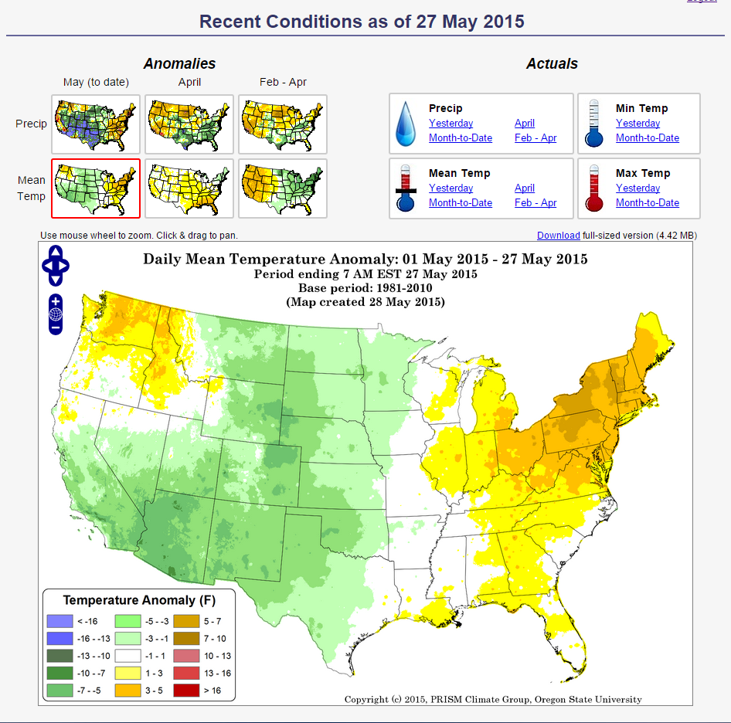
Recent Conditions
Mean Temperature Departure from Normal
May 1-27, 2015

Slide 27
Drought Indicator Tool
Allows adjusters to anticipate where and when claims may be filed, based on developing drought or excess precipitation
Maps back to 1990, so that current conditions can be compared to historical events to gauge severity
PRISM
GROUP

Slide 28
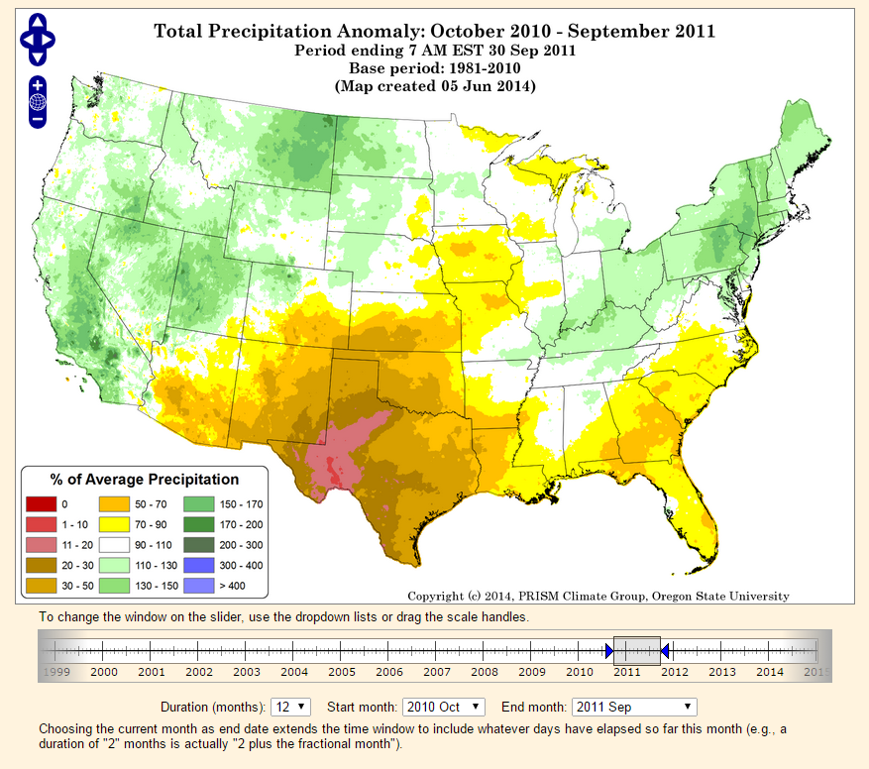
Drought Indicator Tool
Oct 2010 – Sep 2011
Texas Drought

Slide 29
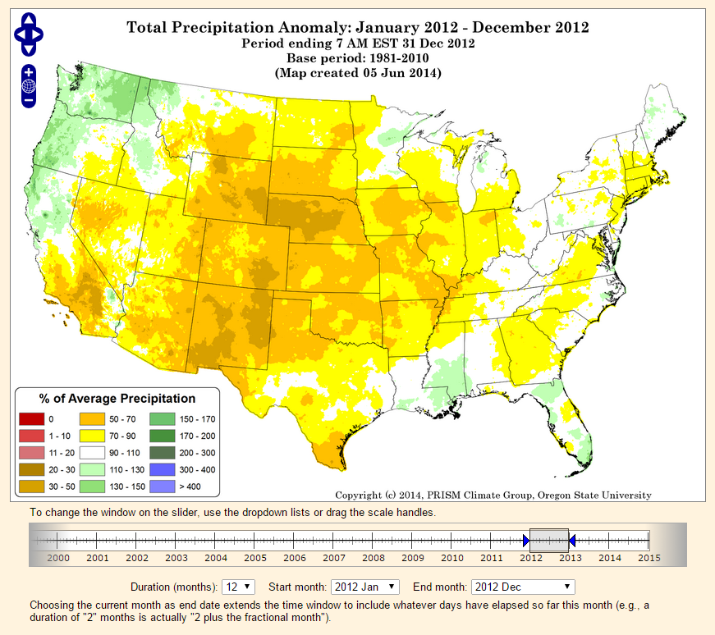
Drought Indicator Tool
Jan – Dec 2012
Plains/Midwest Drought
Developing drought in SoCal

Slide 30
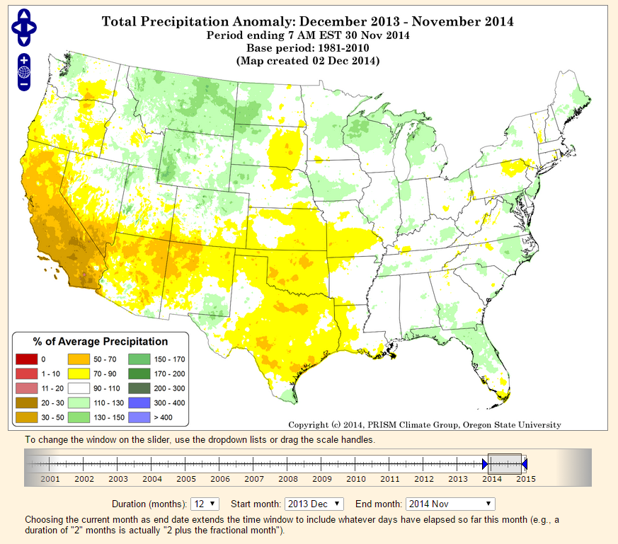
Drought Indicator Tool
Dec 2013 – Nov 2014
California Drought, drying in plains

Slide 31
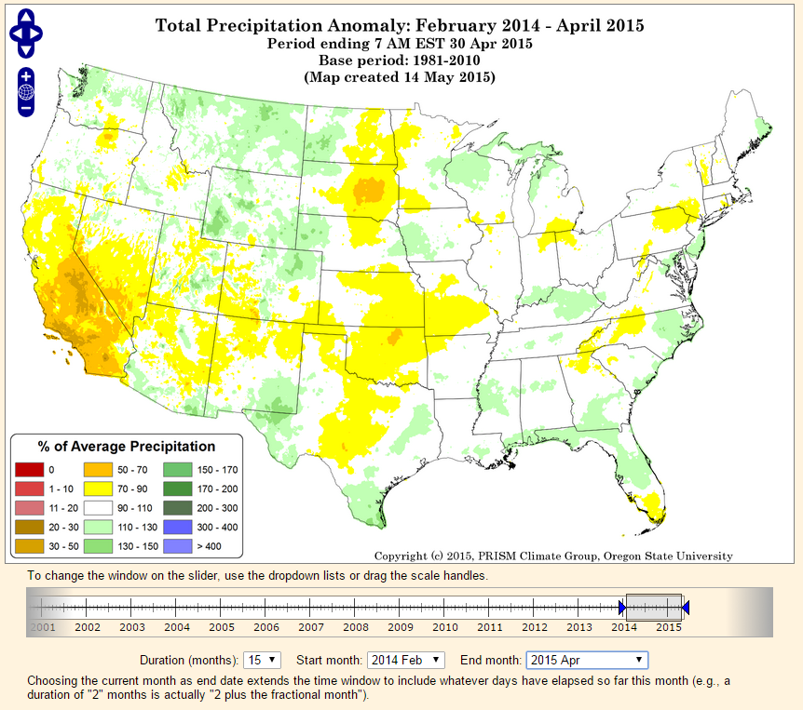
Drought Indicator Tool
Feb 2014 – Apr 2015
Continued dry in CA and plains

Slide 32
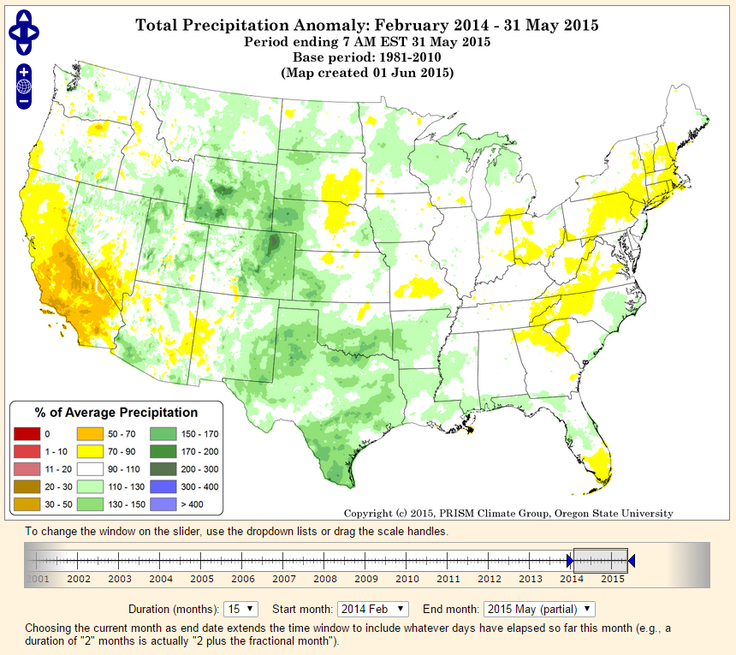
Drought Indicator Tool
Feb 2014 – May 2015
Extremely wet May
Drought broken! Except in California

Slide 33
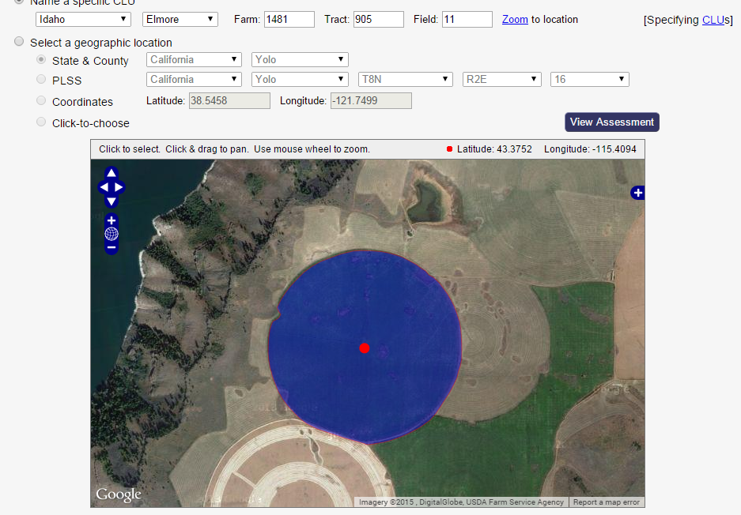
Map Server
Map server allows user to locate a field four different ways:
CLU
(FSA common land unit)
PLSS
(Public Land Survey System)
Latitude/longitude
Click on map
Google-style map views:
Terrain
Roadmap
Satellite
Hybrid
9999
9999
9999
CLU in Elmore County, Idaho

Slide 34
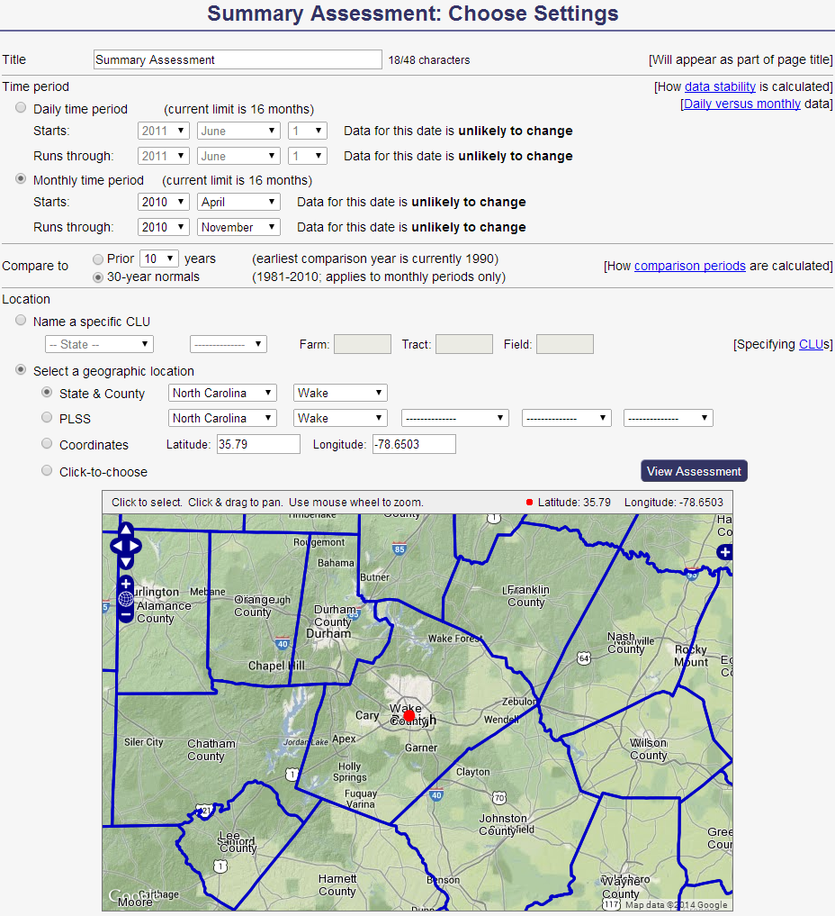
Summary Assessment
General overview of conditions at a site during a user-specified period.
User supplies date range and comparison period (10 to 30 years).
Example: Wake County, NC (Raleigh) 2010 tobacco growing season
Notes:
The summary assessment section is designed for the user to quickly screen a claim by determining if weather conditions were unusual on a field during a specified period.

Slide 35
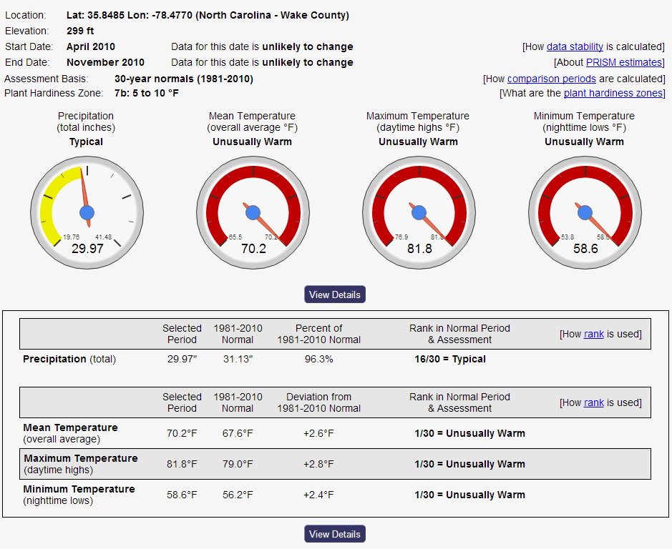
Summary Assessment: Heat Stress During 2010
Deviation from normal
Ranking and
plain-English
interpretation
Notes:
These are example summary assessment results for a tobacco heat damage claim during the 2010 growing season. It is immediately obvious that overall the season was very warm, as indicated by the colored dials. The table below presents the data in two ways: deviation from normal, and ranking over the 1981-2010 normal period (or the most recent 10 years). In this example, temperatures averaged 2-3 degrees above normal, but the user is left to wonder how severe that is. The right-hand side of the table ranks the period among the other 30 years; now we find that temperatures were the highest of all 30 years, ranking 1 out of 30, and the plain English category is “unusually warm.” Detailed data for each year can also be explored by clicking the “View Details” button.

Slide 36
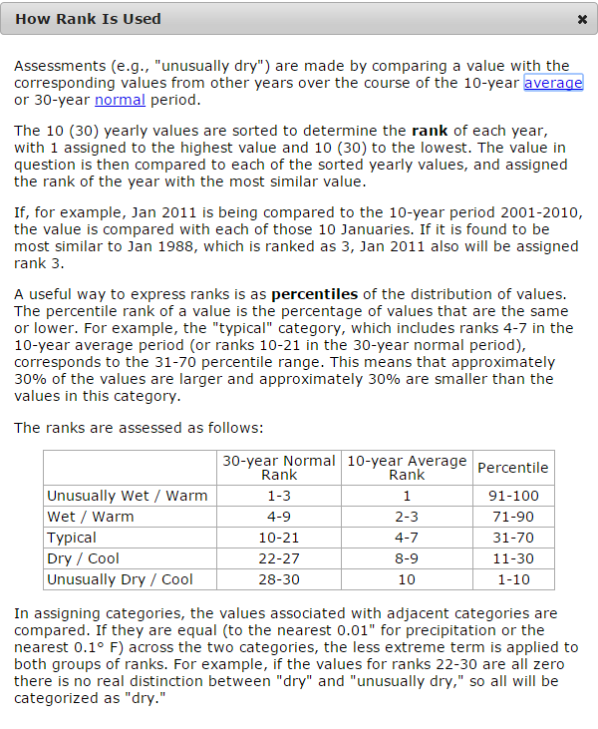
Summary Assessment: Raleigh, NC 2010 Tobacco Season
Deviation from normal
Ranking and
plain-English
interpretation

Slide 37
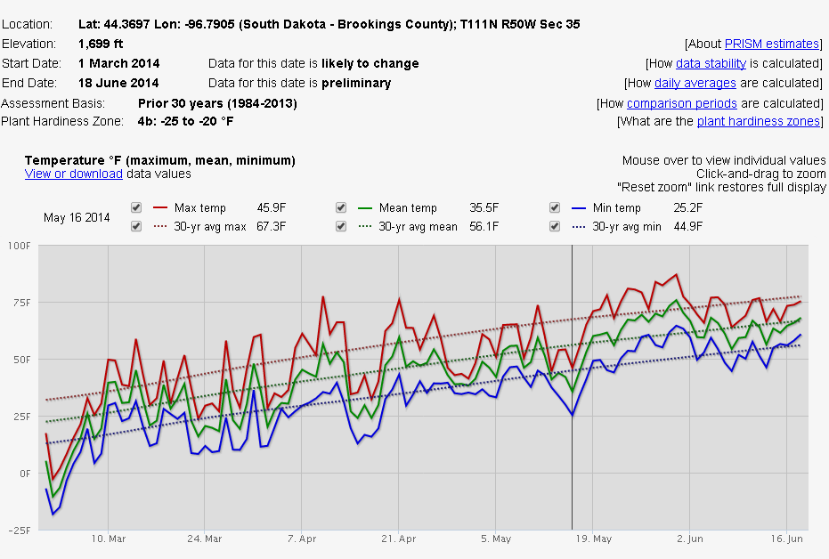
Detailed Data: Late Freeze on May 16, Brookings, SD
Open data in spreadsheet
Mouseover to see values
Notes:
“Power users” wanting to view actual daily or monthly PRISM data for a location and time period can go to the detailed data tab. Here, they can view interactive time series plots of temperature and precipitation data and their long-term averages, download data to a spreadsheet for further analysis, or print out a report.

Slide 38
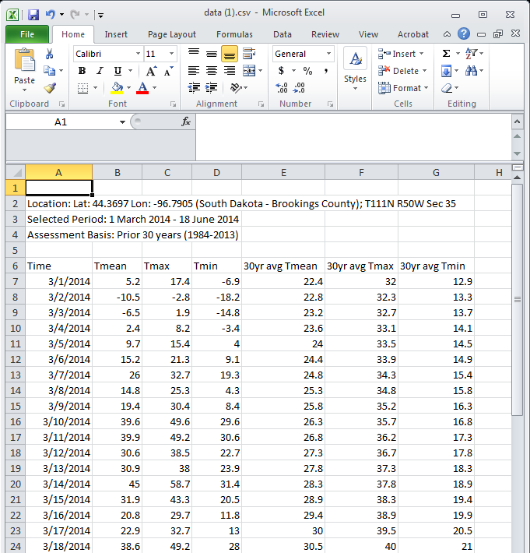
Detailed Data: Hard Freeze May 16, Brookings, SD
Open data in spreadsheet
Mouseover to see values

Slide 39
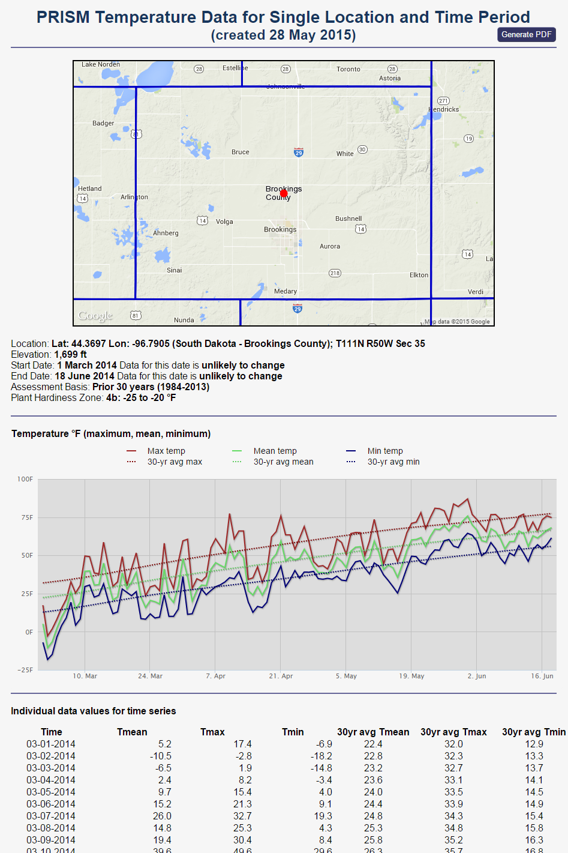
Detailed Data Report (new)
Map showing field location
Daily weather graph
Table with actual weather values
Having everything in one report ensures that weather data corresponds to field location

Slide 40
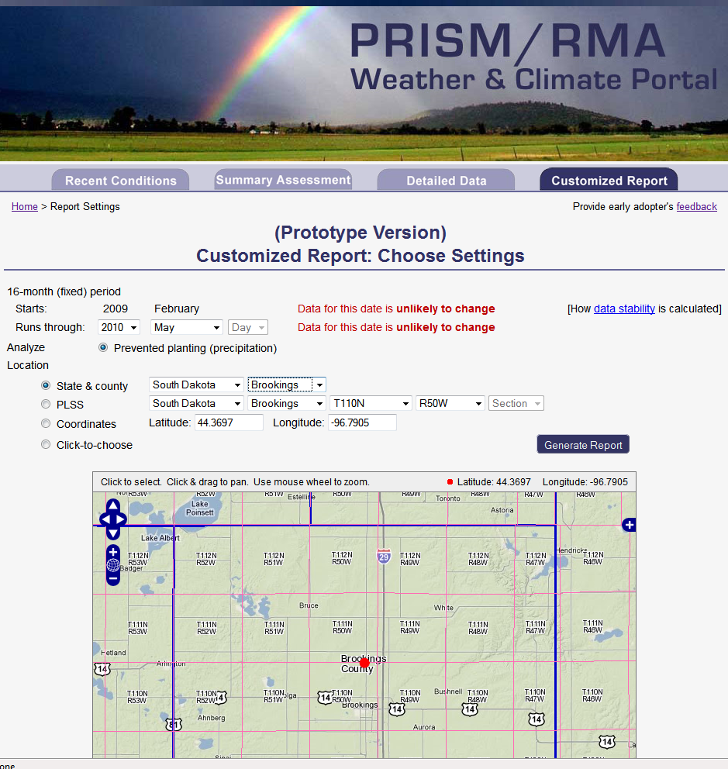
Long-Term Prevented Planting Report
On-demand prevented planting report covering 16-month insurance period
Used in Prairie Pothole region of the Dakotas (poor drainage), where wet fields inhibit planting
Select a planting month and location, and the portal writes the report
Notes:
The customized report tab prepares a report specifically designed to meet the reporting requirements for assessing a prevented planting claim (where the producer is unable to plant a field in a timely manner because of excessive wetness). The user specifies the location of the field and the planting month, and the portal producers a report with full text and graphics in about 30 seconds.

Slide 41
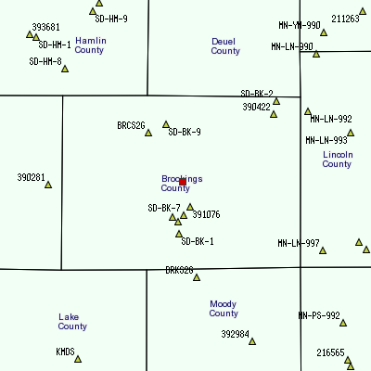
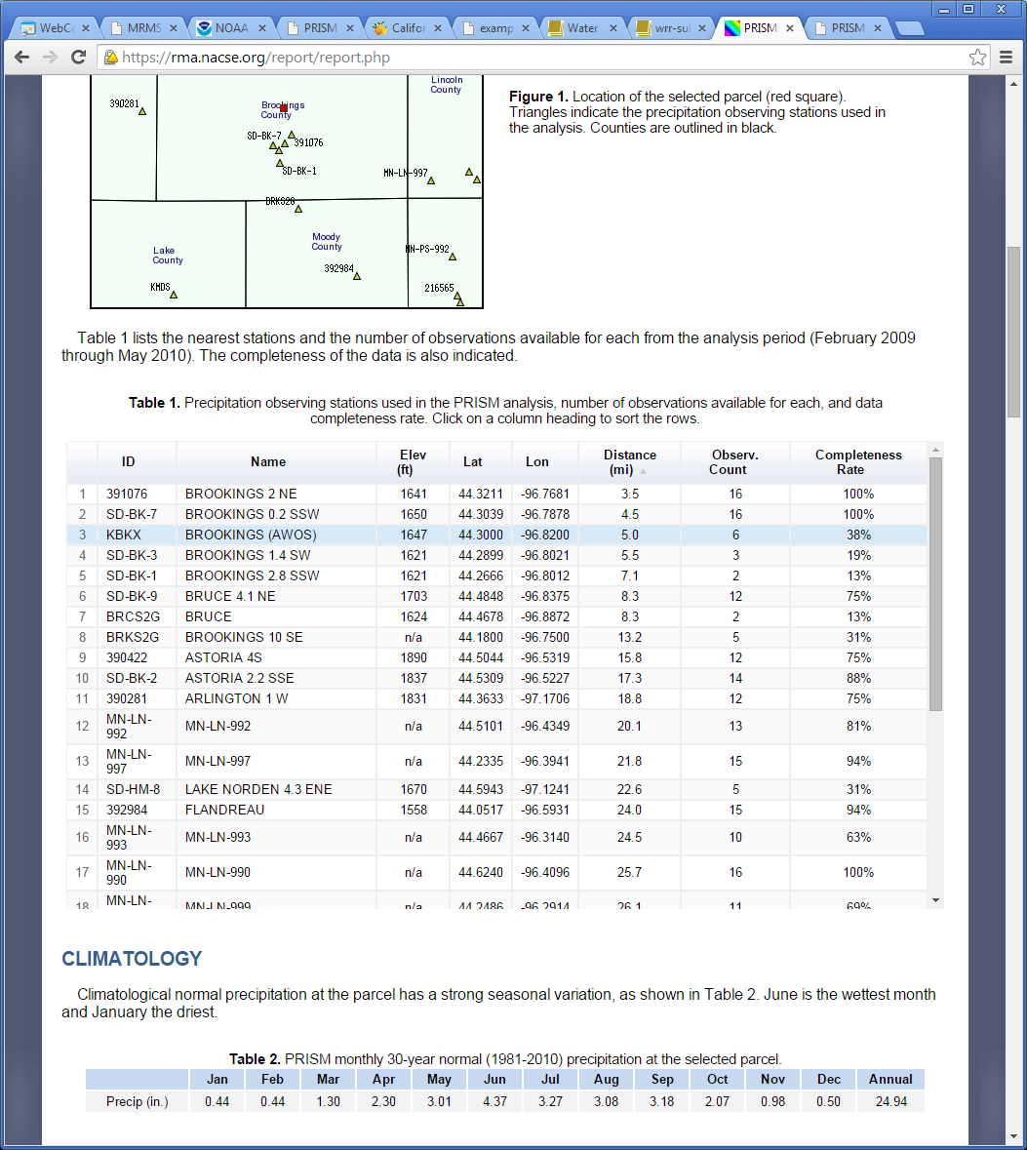
Customized Report – Prevented Planting
Weather station map and table
Notes:
Examples of text and interactive graphics in the report.

Slide 42
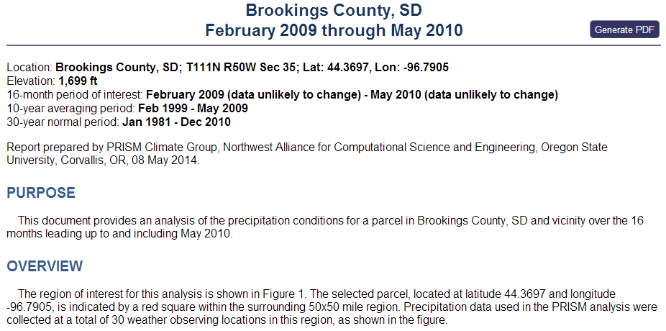
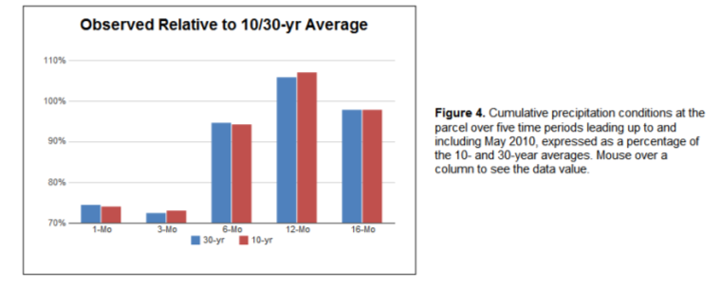
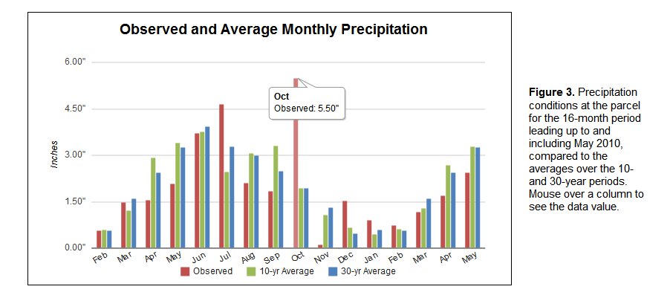
Customized Report – Prevented Planting
Notes:
Examples of text and interactive graphics in the report.

Slide 43
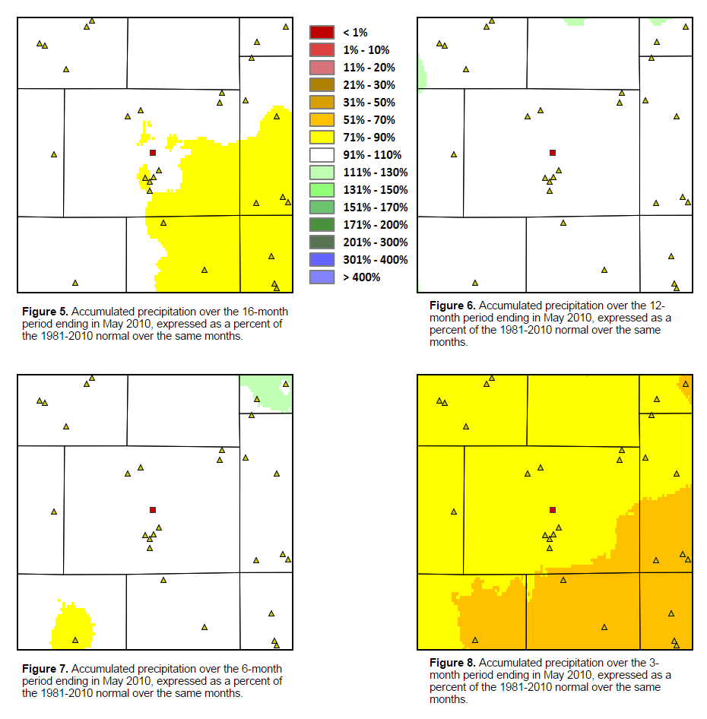
Customized Report – Prevented Planting
Maps showing accumulated precipitation anomalies over the 16-month period
Notes:
Examples of text and interactive graphics in the report.

Slide 44
Coming Fall 2015: Severe Weather
Hail
Strong Winds
Heavy Rain
Combination of mapped products and point reports
PRISM
GROUP

Slide 45
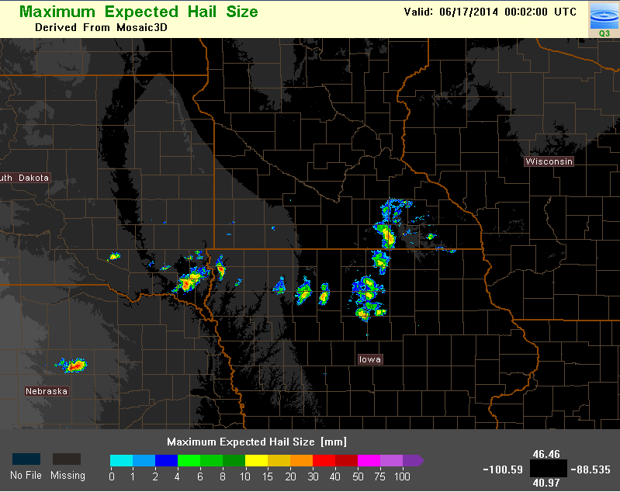
Weather RADAR Mapped Hail Estimates

Slide 46

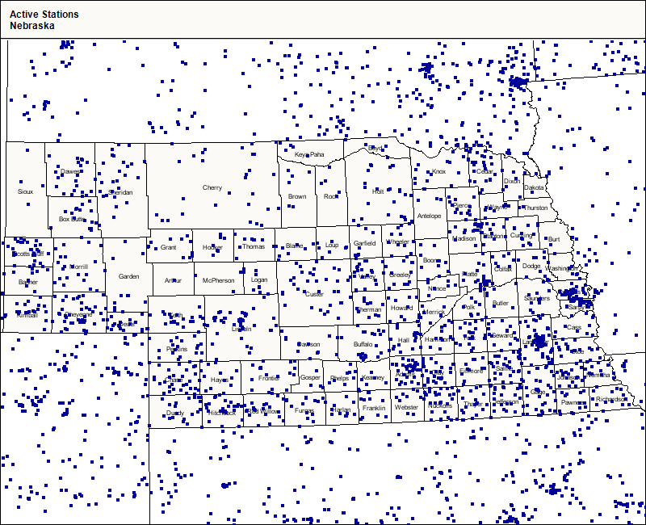
CoCoRaHS Observations
Anyone can
join:
Cocorahs.org

Slide 47
NWS Local Storm Reports (LSRs)
Hail, strong winds, heavy rain
Thousands of trained weather spotters
Emergency Personnel
Law Enforcement
General Public
PRISM
GROUP

Slide 48
NWS Local Storm Reports (LSRs)
4 July 2014
CALDWELL | BURLESON | TX | 3053 | 9670 | QUARTER SIZE HAIL REPORTED IN CALDWELL. (HGX)
4 E DOWNTOWN CUSTER | CUSTER | SD | 4377 | 10352 | SUNNY WITH A FEW GOLF BALL SIZE HAIL STONES FALLING (UNR)
3 E DOWNTOWN CUSTER | CUSTER | SD | 4377 | 10354 | HAIL OBSERVED ON THE GROUND FOR ABOUT 1 MILE ALONG THE ROAD. (UNR)
HARRISON | SIOUX | NE | 4269 | 10388 | THE FIRE DEPARTMENT REPORTED MAINLY QUARTER SIZED HAIL IN HARRISON WITH A FEW HAIL STONES THE SIZE OF GOLF BALLS. (CYS)
7 SSE FAIRBURN | CUSTER | SD | 4359 | 10316 | HAIL LASTED FROM 2000 TO 2020 MDT. MOST MARBLE SIZE BUT SOME HALF-DOLLAR SIZE. MAX SIZE AROUND 2010 MDT. (UNR)
2 NW LITTLE SIOUX | HARRISON | IA | 4183 | 9605 | SOME HAIL STONES MAY HAVE BEEN BIGGER. ALSO WIND GUSTS ESTIMATED AT 60 MPH WITH SMALL TREE LIMBS DOWN. (OAX)
PRISM
GROUP

Slide 49
PRISM/RMA Portal Usage
Number of User Accounts
PRISM
GROUP

Slide 50
Training/Feedback
Several meetings with adjusters so far, representing about 10 AIPs
Very useful feedback, adjusters engaged
Feedback has turned into several portal improvement tasks
Requests are made to Joe Stinar (RMA) for training/feedback sessions
Training videos in progress
PRISM
GROUP

Slide 51
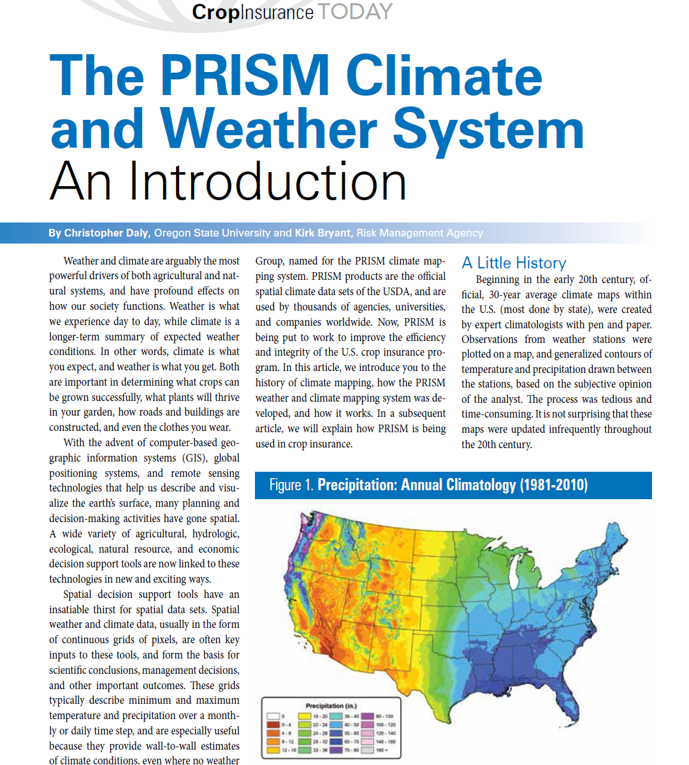
PRISM Background Article #1
Introduction to the PRISM Climate and Weather System
Crop Insurance Today
August 2013

Slide 52
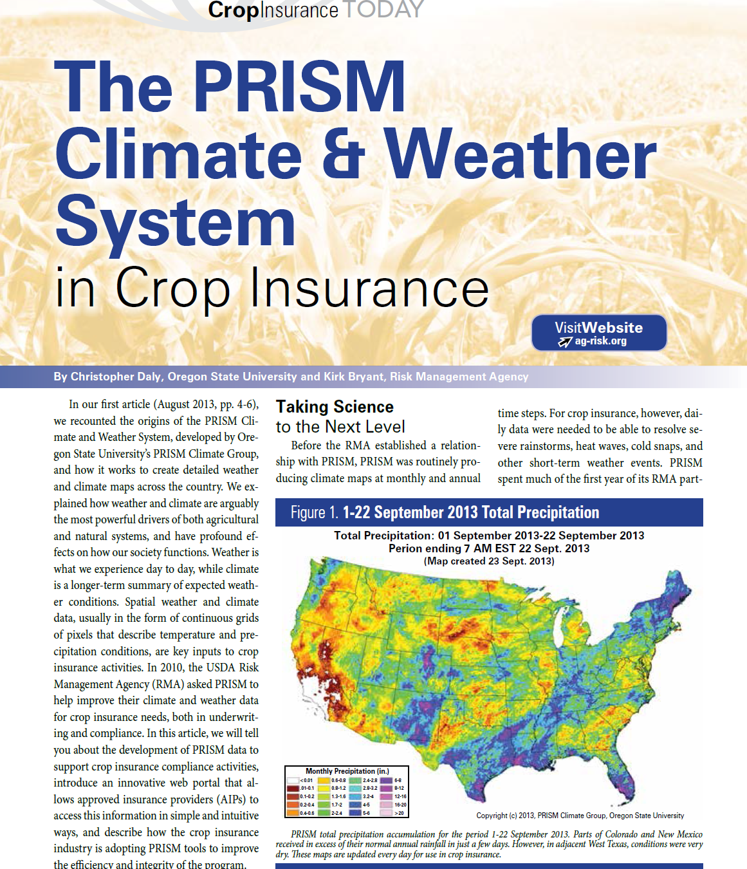
PRISM Background Article #2
Applying the PRISM System to Crop Insurance
Crop Insurance Today
September 2014

